Slide 1
Basic Concepts and Terminology
Unit 1 : part II
Notes:
1

Slide 2
Cloud
Notes:
2

Slide 3
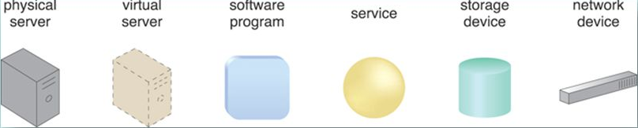
IT Resources and corresponding symbols
Notes:
3

Slide 4
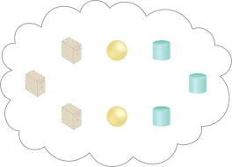
Cloud Holding Resources
Virtual servers:? , Cloud Services: ? , Storage Devices: ?
Notes:
4

Slide 5
On-Premise
On-Premise : An IT resource located within premises of organization and is not cloud based.
An on-premise IT resource can access and interact with a cloud-based IT resource.
An on-premise IT resource can be moved to a cloud.
Redundant deployments of an IT source can exist in both places.
Notes:
5

Slide 6
Cloud Consumer and Cloud Provider
Cloud Provider: A party that provides cloud-based IT resources is the cloud provider.
Cloud Consumer: A party which that uses cloud-based IT resources is the cloud consumer.
Notes:
6

Slide 7
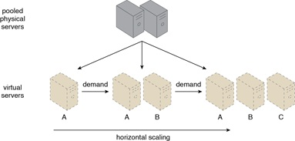
Horizontal Scaling
Horizontal Scaling: The allocating or releasing of IT resources that are of same type.
Horizontal Scaling: Scaling out and scaling in.
Notes:
7

Slide 8
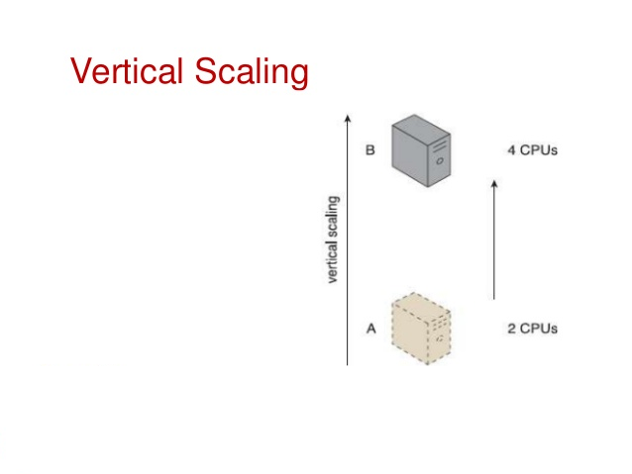
Vertical Scaling
Vertical Scaling: Existing resource is replaced by another with higher or lower capacity.
Vertical Scaling: Scaling up and scaling down.
Notes:
8

Slide 9
Comparison
Horizontal Scaling | Vertical Scaling
Less expensive (commodity hardware) | More expensive (specialized servers)
IT resources instantly available | IT resources normally instantly available
Resource replication and automated scaling | Additional setup is normally needed
Additional IT resources needed | No additional IT resources needed
Not limited by H/W capacity | Limited by max H/W capacity
Notes:
9

Slide 10
Cloud Service
A cloud service is any IT resource that is made remotely accessible via a cloud.
Although , not all resources can be made available for remote access.
A DB or physical server deployed within a cloud may only be accessible only by those who lie within the same cloud.
Notes:
10

Slide 11
Cloud Service…
Draw a diagram with the help of IT resources to represent the following:
i)Remotely accessed web service acting as a cloud service
ii)Remotely accessed virtual server acting as a cloud service.
Notes:
11

Slide 12
Goals and Benefits
Reduced Investments and Proportional Costs
On-demand access to pay-as-you-go computing resources on a short-term basis (such as processors by the hour), and the ability to release these computing resources when they are no longer needed.
• The perception of having unlimited computing resources that are available on demand, thereby reducing the need to prepare for provisioning.
• The ability to add or remove IT resources at a fine-grained level, such as modifying available storage disk space by single gigabyte increments.
Notes:
12

Slide 13
Goals and Benefits
Abstraction of the infrastructure so applications are not locked into devices or locations and can be easily moved if needed.
Using 100 servers for one hour costs the same
as using one server for 100 hours. This “elasticity” of IT resources, achieved without requiring steep initial investments to create a large-scale computing infrastructure, can be extremely compelling.
Notes:
13

Slide 14
Goals and Benefits…
Increased Scalability:
  Cloud consumer’s direct configuration
  Dynamic allocation of IT resources
  The Lag and Match strategy
  Increased Availability and Reliability:
  Outages limit the time
  Limits the revenue generation
  Unexpected failures
Notes:
14

Slide 15
Risk and Challenges
Increased Security Vulnerabilities
  Data security becomes shared responsibility with cloud owner.
  Compatible security framework- Unlikely with public cloud.
  Overlapping trust boundaries: cloud provider’s privileged access to cloud consumer data.
  Opportunity for malicious cloud consumers due to overlapping.
  Multitenancy: a big BIG problem
Notes:
15

Slide 16
Risk and Challenges
Reduced Operational Governance Control
  Level of Governance Control: It is lower than that over on premise IT resources.
  External connections between cloud and consumer required for communication may get intercepted.
  Additional network hops , fluctuating latency and potential bandwidth constraints.
Notes:
16

Slide 17
Risk and Challenges
Limited portability between cloud Providers:
  Many Cloud consumers have custom built solutions with dependencies on proprietary environments which makes it difficult to move from one cloud provider to another.
  Portability is the measure used to determine the impact of moving consumer IT resources and data between clouds.
Notes:
17

Slide 18
Risk and Challenges
Multi-Regional Compliance and Legal Issues
  Data centres are at convenient geographical locations.
  Serious concerns due to government regulations.
  Data of UK citizen must be in UK, as per UK law.
  Some country’s law makes it mandatory to disclose it to certain government agencies.
  European cloud consumer’s data can be accessed easily in US due to US Patriot Act than data located in many European Union Countries.
Notes:
18

Slide 19
Roles and Boundaries
Cloud Provider
  The Organization that provides cloud based IT resources is the cloud provider.
Cloud Consumer
  It is an Organization or a human that has formal contract or arrangement with a cloud provider to use IT resources made available by the cloud provider.
Cloud Service Owner
  It is an Organization or a human that legally owns a cloud service is called Cloud service Owner
Notes:
19

Slide 20
Roles and Boundaries
Cloud Resource Administrator
  A Cloud resource administrator is the person or organization responsible for administrating a cloud based IT resource. It can be a cloud consumer or provider within which cloud services reside.
Organizational Boundary
  Physical Perimeter that surrounds a set of IT resources that are owned and governed by an organization.
Notes:
20

Slide 21
Additional Roles
Cloud Auditor
  A third party that conducts independent assessments of cloud environments assumes the role of the cloud auditor.
  Cloud Broker
  Assumes the responsibility of managing and negotiating the usage of cloud services between consumer and provider.
  Cloud Carrier
  Wire level connectivity between consumer and provider
Notes:
21

Slide 22
Cloud Characteristics
Six characteristics common to majority of environments
On-demand usage
Ubiquitous access
Multitenancy
Elasticity
Measured Usage
Resiliency: During failover, processing is automatically handed over to another redundant resource.
27/12/17

Slide 23
Cloud Delivery Models
Infrastructure-as-a-Service (IaaS)
Platform-as-a-Service(PaaS)
Software-as-a-Service(SaaS)
Specialized variations
  Storage-as-a-Service
  Database-as-a-Service
  Security-as-a-Service
  Communication-as-a-Service
  Integration-as-a-Service
  Testing-as-a-Service
  Process-as-a-Service
27/12/17

Slide 24
Infrastructure-as-a-Service (IaaS)
Represents a self-contained IT environment comprised of infrastructure-centric IT resources.
These are managed and accessed via cloud based services and tools.
IaaS environment contains H/W, network, connectivity, O.S. and other “Raw” IT resources.
27/12/17

Slide 25
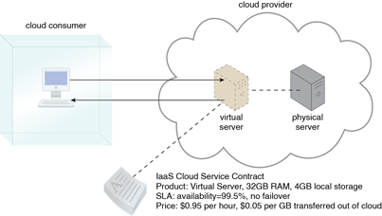
Infrastructure-as-a-Service (IaaS)
27/12/17

Slide 26
Platform-as-a-Service (PaaS)
Represents a pre-defined “ready-to-use” environment.
IT resources are already configured and deployed along with pre-packaged products and tools.
Common reasons Consumer would use and invest in PaaS :
  Extend On-Premise environments into cloud for Scalability and economic purposes.
  Availability of readymade environment to substitute on-premise environment.
27/12/17

Slide 27
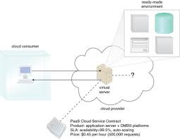
Platform-as-a-Service (PaaS)
27/12/17

Slide 28
Software-as-a-Service (PaaS)
A software program positioned as a shared cloud service and made available as a “product”.
A cloud consumer while working with PaaS environment can build a service and decides to deploy it in same environment as SaaS offering.
27/12/17

Slide 29
Software-as-a-Service (SaaS)
27/12/17

Slide 30
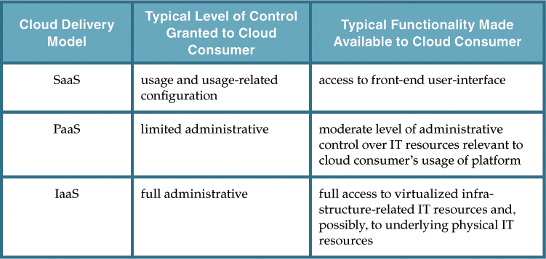
Comparison of cloud delivery model
27/12/17

Slide 31
Activities carried out by cloud consumers and providers
27/12/17

Slide 32
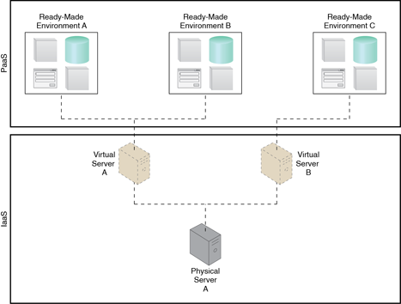
Combining Cloud delivery models IaaS + PaaS
27/12/17

Slide 33
Cloud Deployment Models
1) Public Cloud
2) Community Cloud
3) Private Cloud
4) Hybrid Cloud
27/12/17

Slide 34
Public Cloud
A Public Cloud is a publicly accessible cloud environment
owned by a third-party cloud provider.
Cloud Provider is responsible for the creation and on-going
maintaince of the public cloud and its IT resources.
27/12/17

Slide 35
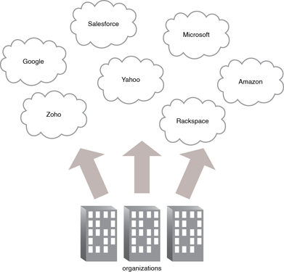
Public Cloud
27/12/17

Slide 36
Community Clouds
A community cloud is similar to Public Cloud except access
  is limited to a specific community of cloud consumers.
Community may be jointly owned by the community
members or a third party cloud provider.
27/12/17

Slide 37
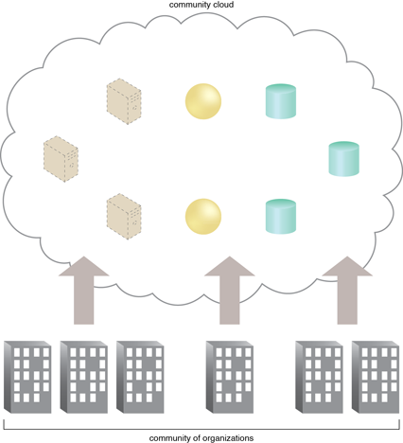
Community Cloud
27/12/17

Slide 38
Private Cloud
A Private cloud is owned by a single organization.
Private cloud is a means of centralizing access to IT resources
by different parts , locations or departments of the organization.
Same organization is technically both the cloud consumer
and cloud provider.

Slide 39
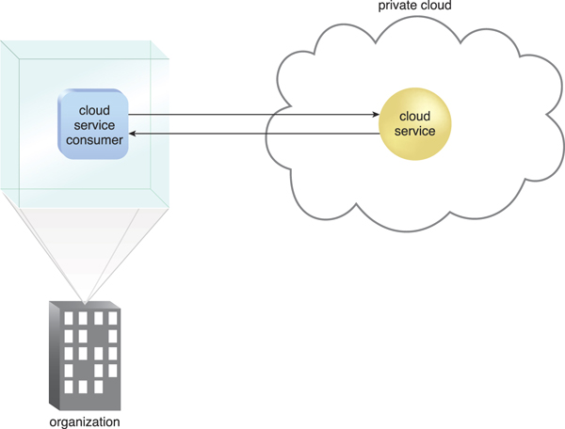
Private Cloud
27/12/17

Slide 40
Hybrid Cloud
Hybrid Cloud is comprised of two or more cloud deployment.
For eg. A cloud consumer may choose to deploy cloud
Services processing sensitive data to a private cloud and other
Less sensitive to a public cloud.

Slide 41
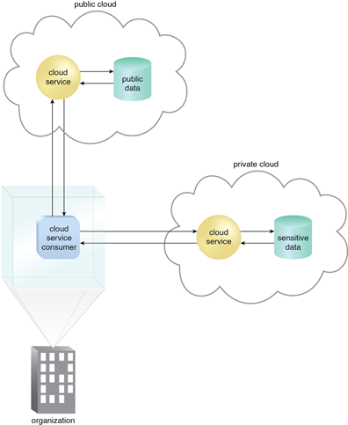
Hybrid Cloud
27/12/17

Slide 42
Cloud Enabling Technology
Broadband Networks and Internet Architecture
Data Center Technology
Virtualization Technology
Web Technology
Multitenant Technology
Service Technology

